Slide 1

Project Name
Web Application
Presented by
Satya, Raj Kumar & Samir
Date: 30-April-2024

Slide 2
Introduction
The OrangeHRM web application gives HR team the tool need to streamline administrative tasks, support employees, and make informed decisions with the OrangeHRM free and open source HR software.
Overview

Slide 3
Functional Testing: Ensure all features and modules of the OrangeHRM web application function correctly.
OBJECTIVE
Usability Testing: Evaluate the user-friendliness and intuitiveness of the OrangeHRM web application.
Compatibility Testing: Verify that the OrangeHRM web application functions correctly across different browsers and devices.

Slide 4
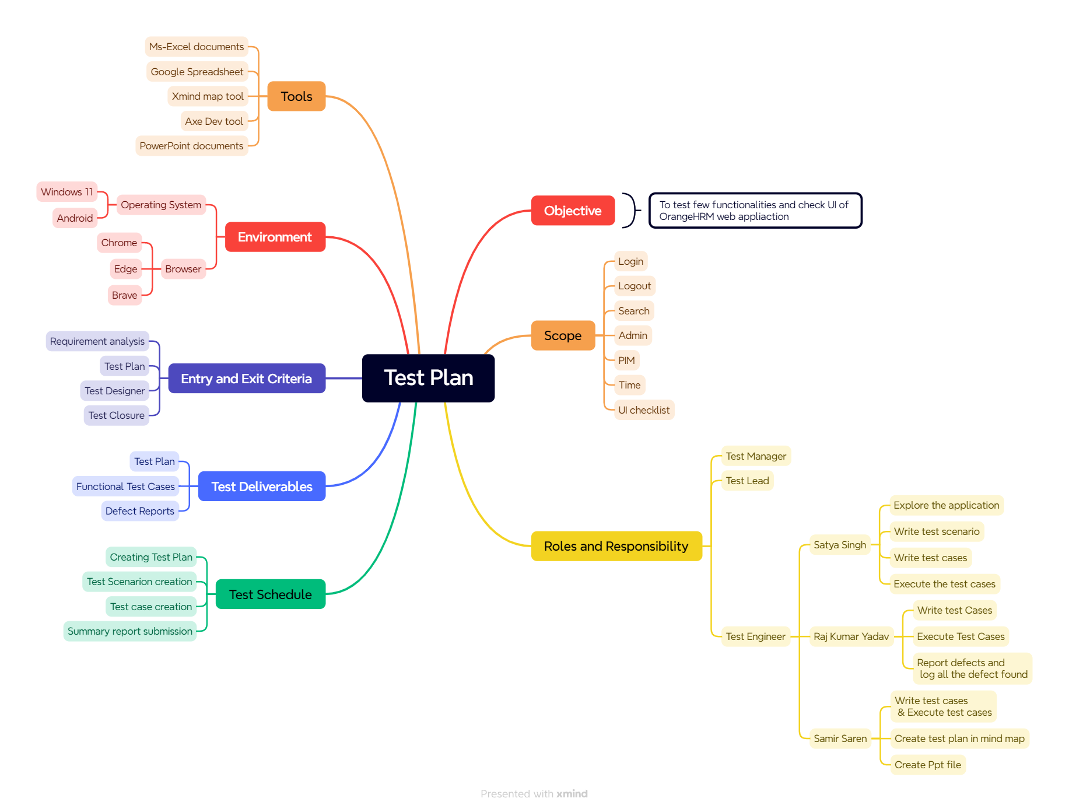

Slide 5
Roles and Responsibility
Name | Role | Responsibility
Satya Singh | Test Engineer | Explore the application Write Test Scenario Write Test Cases Execute Test Cases
Raj Kumar Yadav | Test Engineer | Explore the application Write Test Cases Execute Test Cases Report Defects and log all the defect found
Samir Saren | Test Engineer | Explore the application Write Test Cases Create Mind Map Create PPT file Merge All documents

Slide 6
Test Schedule
Task | Responsible owner | Time Duration
Creating Test Plan | Samir | 29-April-2024 (1PM to 4:30 PM)
Test Scenario Creation | Satya | 29-April-2024 (1 PM to 6 PM)
Test Case Creation | Satya, Raj Kumar, Samir | 29-April-2024 to 30-April-2024
Defect Report | Raj Kumar | 29-April-2024
Summery Report Submission | Team | 30-April-2024 at 2 PM

Slide 7
Test Deliverables
Deliverables | Responsible owner | Target Completion Time
Creating Test Plan | Samir | 29-April-2024 - 4:30 PM
Test Scenario Creation | Satya | 29-April-2024 - 6 PM
Test Case Creation | Satya, Raj Kumar, Samir | 30-April-2024 - 11 AM
Defect Report | Raj Kumar | 30-April-2024 – 9AM
Summery Report Submission | Team | 30-April-2024 at 2 PM

Slide 8
Entry and Exit Criteria
1 | Requirements Analysis |  | 2 | Test Planning
Entry Criteria: Once Our team receives the Requirements Documents or project details about the Project which serves as the foundation for the testing process, providing the testing team with insights into what needs to be tested and how the software should behave. Exit Criteria: Our team should thoroughly explore and understand each requirement listed in the documents or project details, what needs to be tested and how it should behave. |  |  | Entry Criteria: Testable Requirements derived from the given Requirements Documents or Project details Any doubts or uncertainties regarding the requirements should be addressed and clarified to ensure that the testing team has a clear understanding of what needs to be tested and how it should behave. Exit Criteria: Test Plan document created which provides a high-level overview of how testing will be conducted.

Slide 9
Entry and Exit Criteria
3 | Test Execution |  | 4 | Test Closure
Entry Criteria: Our team write test Scenario and test cases and reviewed the testing in web appliction. Exit Criteria: Create Test Report and Defect report. |  |  | Entry Criteria: Test Report and Defect Report are ready. Exit Criteria: Ready to Test summery Report. It is overview of entire testing process.

Slide 10





Environments
Operating
System
Android
Browser
Google Chrome Edge Brave

Slide 11



Tools Used
Ms-Excel
Google Spreadsheet
Xmind Map Tool
PowerPoint

Slide 12
Thank You

